Slide 1


Andy Hadian Shah
25th October 2025

Slide 2

Outline
Executive Summary
Introduction
Methodology
Results
Conclusion
Appendix

Slide 3
Executive Summary
Summary of methodologies
Data Collection from APIs and Web Scraping
Data Wrangling
EDA with Data Visualization and SQL
Interactive Maps and Dashboards
Predictive Analysis with Machine Learning
Summary of all results
Decision Tree Classifier outperformed the other tested classifiers
The classifier was able to predict the outcome of a mission to be either successful or failure consistently with lower precision

Slide 4
Introduction
SpaceX spends around $62 million to conduct their space launches while other provides spend around $165 million. SpaceX can do so by reusing their first stage of the rocket. By being able to predict whether a rockets first stage can be reused and determine the price of a mission predictively, which can be used for mission biddings against SpaceX or help SpaceX with improving the chances of their launches being successful.
To be able to do this, we need to know where can we collect data of SpaceX launches, what are the hidden patterns between columns of the dataset and what classifier is the best to predict whether a mission is successful or a failure.

Slide 5

Section 1

Slide 6
Methodology
Executive Summary
Data collection methodology:
Using APIs and Webscraping from appropriate sources
Perform data wrangling
Filtering for only Falcon 9 Launches, Removing missing data, analysis of categorical columns, and creating class label column
Perform exploratory data analysis (EDA) using visualization and SQL
Perform interactive visual analytics using Folium and Plotly Dash
Perform predictive analysis using classification models
Dataset is prepared for training and testing models, multiple classifiers are trained and evaluated accordingly and the best forming model in accurately predicting mission outcomes is picked to be used for predictive analysis.

Slide 7
Data Collection
The datasets used in this analysis made use of APIs to extract data directly from related sources, specifically from SpaceX’s APIs, while also using web scraping to extract launch records from sources like Wikipedia tables.
SpaceX
APIs
Data Collection
Webscraping
Wikipedia

Slide 8
Data Collection – SpaceX API
SpaceX
Data was given from the SpaceX APIs. They were then merged into a single dataset where only Falcon 9 launches were kept. The data was then wrangled to remove missing data from PayloadMass
Flowchart of the process can be seen in the diagram to the right
GitHub URL: https://github.com/Swasbuckler/DataScienceAppliedCapstone/blob/main/jupyter-labs-spacex-data-collection-api.ipynb
HTTP request to multiple APIs
Merging data from APIs and transforming and setting types
Data Collection
Data Consolidation
Only include Falcon 9 launches
Removing rows that held missing data from column PayloadMass
Filtering
Removing Missing Data

Slide 9
Data Collection - Scraping
Wikipedia
Data was scrapped from the Wikipedia of Falcon 9 Launches. BeautifulSoup was used to parse through the html and extract data from the launches table and saved in a dataset.
Flowchart of the process can be seen in the diagram to the right
GitHub URL: https://github.com/Swasbuckler/DataScienceAppliedCapstone/blob/main/jupyter-labs-webscraping.ipynb
Webscraping of Falcon 9 Launches
Data Collection
Initialize BeautifulSoup Object
Extracted Column names from html
BeautifulSoup Object
Column Names
Parsing html to create DataFrame
DataFrame Creation

Slide 10
Data Wrangling
Data from the SpaceX APIs were taken, which had previously been filtered for only containing Falcon 9 launches and cleaned of missing values. The data was then analyzed of the value counts of categorical columns like Launch Sites, Orbits and Outcomes. A label binary class was then added to the dataset named “class” for successful and failure outcomes.
Flowchart of the process can be seen in the diagram to the right
GitHub URL: https://github.com/Swasbuckler/DataScienceAppliedCapstone/blob/main/labs-jupyter-spacex-Data%20wrangling.ipynb
Data Collection
SpaceX Dataset
Filtered for Falcon 9 launches, and removing rows that held missing data from column PayloadMass
Raw Dataset
Cleaned Dataset
Value counts of categorical columns
Categorical Column Analysis
Adding class column for successful and failure outcomes
Adding Binary Label Class

Slide 11
EDA with Data Visualization
The Charts used for Data Visualization include Catplots, Scatter Plots, Bar Plot and Line Plot.
Catplots, Scatter Plots and Bar Plot were chosen to help show the relationship between categorical and numeric columns. Doing so helped with identifying the hidden patterns found between columns like Orbits, Launch sites, Flight numbers, Payload mass etc.
Line Plot was used to learn of time series patterns through the years.
GitHub URL: https://github.com/Swasbuckler/DataScienceAppliedCapstone/blob/main/edadataviz.ipynb

Slide 12
EDA with SQL
SQL queries that have been used to extract data from the dataset which includes,
Unique data of columns
Extract specific rows based on conditions such as Launch site starting with a substring, first ever launch date, etc.
Using aggregate functions to determine average, count, sum, min and max values
GitHub URL: https://github.com/Swasbuckler/DataScienceAppliedCapstone/blob/main/jupyter-labs-eda-sql-coursera_sqllite.ipynb

Slide 13
Build an Interactive Map with Folium
Iterative maps were used to position launch sites across the earth to compare where they are from one another, whilst also seeing their proximity to other locations on earth, like with other cities and roads.
Markers, Labels, Circles and Lines help with positioning launch sites on the map no matter how far the maps are zoomed out for better a user experience. Lines and labels helped to identify what is being seen on the map and view distances between locations.
GitHub URL:
https://github.com/Swasbuckler/DataScienceAppliedCapstone/blob/main/lab_jupyter_launch_site_location.ipynb

Slide 14
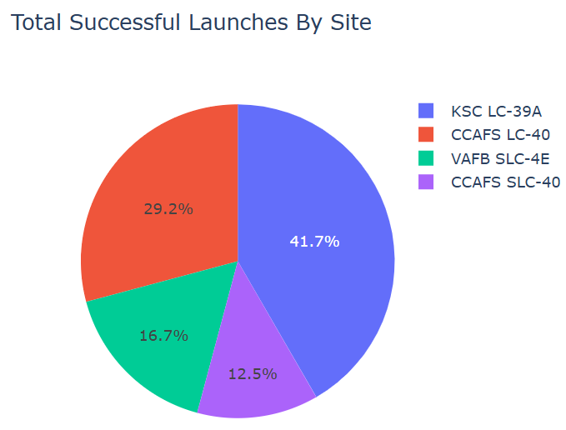
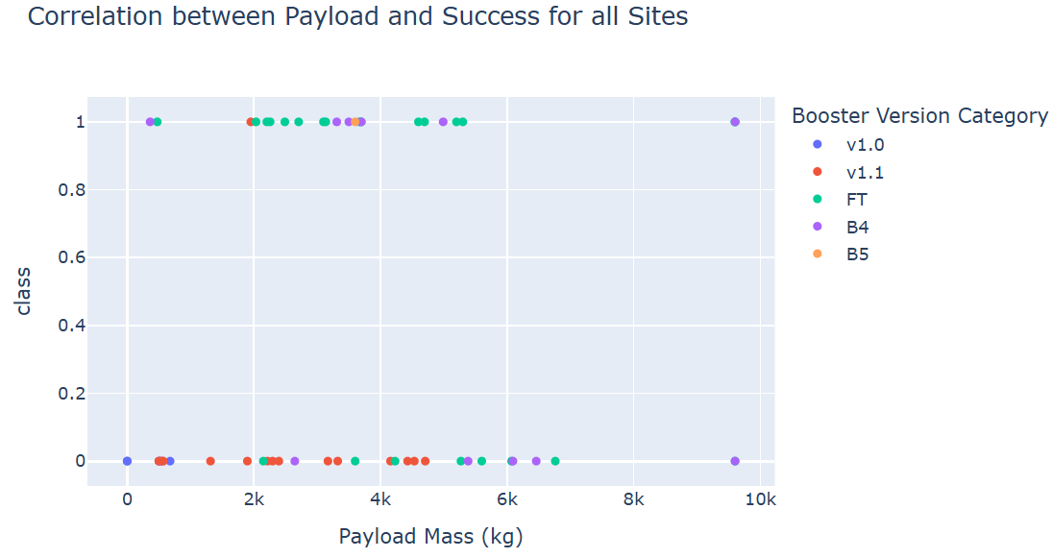
Build a Dashboard with Plotly Dash
Pie charts and scatter plots were shown where users can interact with them through a dropdown and range selector.
For the dropdown, users can select to view data on all launch sites or a specific site. While the range selector selects on the scatter plot mass.
These interactivity helps user to make a
GitHub URL: https://github.com/Swasbuckler/DataScienceAppliedCapstone/blob/main/spacex-dash-app.py

Slide 15
Predictive Analysis (Classification)
The processed data after data wrangling is separated to a feature and label sets. The feature set is then scaled and the whole dataset is split into a train and test set with 20% going to the testing set. GridSearchCV is used to do Cross Validation of 10 and find the best parameters for classifiers Logistic Regression, Support Vector Classifier, Decision Tree and K-Nearest Neighbour. The classifiers are evaluated on accuracy and the best performing one is picked.
Flowchart of the process can be seen in the diagram to the right
GitHub URL: https://github.com/Swasbuckler/DataScienceAppliedCapstone/blob/main/SpaceX_Machine%20Learning%20Prediction_Part_5.ipynb
Processed Data
Creating feature set of X and label set y
Features and Class Set
Scaling feature set with Standard Scaling
Splitting the data to training and testing sets with train_test_split
Data Scaling
Training and Cross validation with multiple classifiers using GridSearchCV
Train Test Split
Evaluating dataset with testing set and comparing performance to pick the best
Training and Cross Validation
Picking Best Classifier

Slide 16
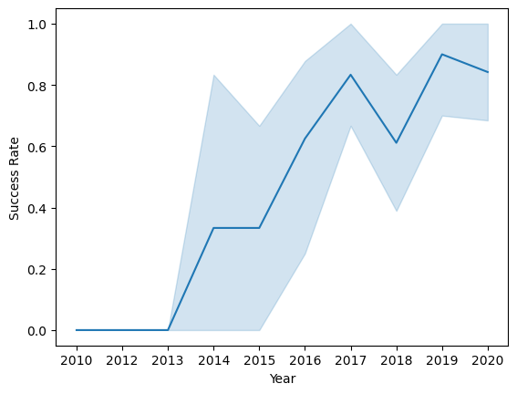

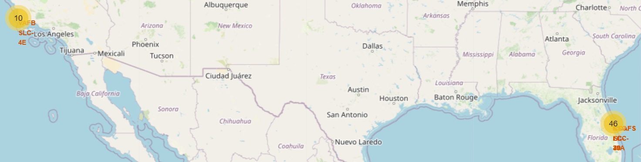
Results
Interactive analytics:
Launch sites placed on an interactive map
Sites are near coasts and away from human settlements
EDA analysis:
Over the years mission success rates increases
Predictive analytics:
Decision Tree Classifier had the best accuracy
Model can accurately determine if the mission will fail or succeed

Slide 17

Section 2

Slide 18
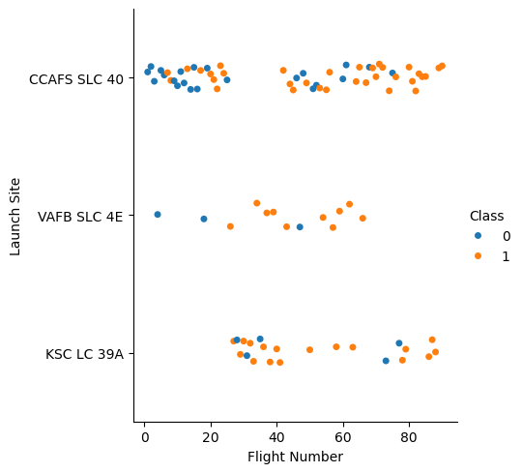
Flight Number vs. Launch Site
Sites CCAFS SLC 40 and VAFB SLC 4E have been used for early launches while site KSC LC 39A appears to be a newer site, only starting to have launches after flight number 20.
Site CCAFS SLC 40 had the greatest number of launches while site VAFB SLC 4E has the lowest number.

Slide 19
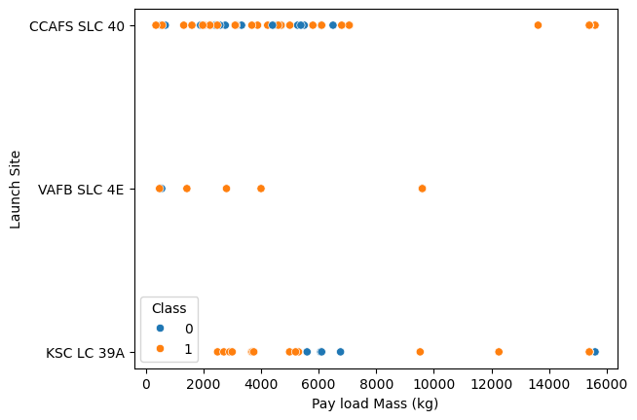
Payload vs. Launch Site
Sites CCAFS SLC 40 and KSC LC 39A have more launches compared to site VAFB SLC 4E
The two sites also perform missions with large payloads, while site VAFB SLC 4E only ever handled payloads of less than 10000 kg

Slide 20
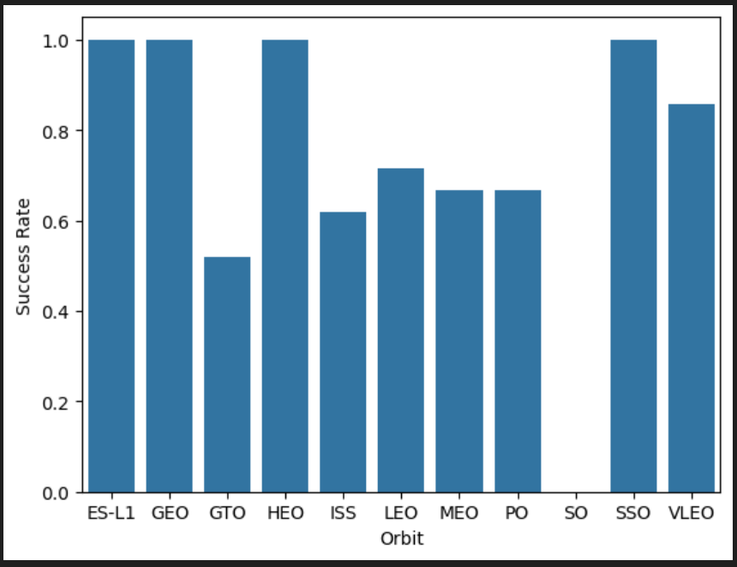
Success Rate vs. Orbit Type
For orbits that are not commonly launched for, the success rates are either very high like with ES-L1, GEO, HEO, SSO or very low as with SO. MEO also has low samples and therefore with these orbits we can’t extract accurate information without more launches.
For other more common launches, like GTO and ISS, they have success rates of 50% and above, showing that SpaceX typically have positive outcomes with their missions

Slide 21
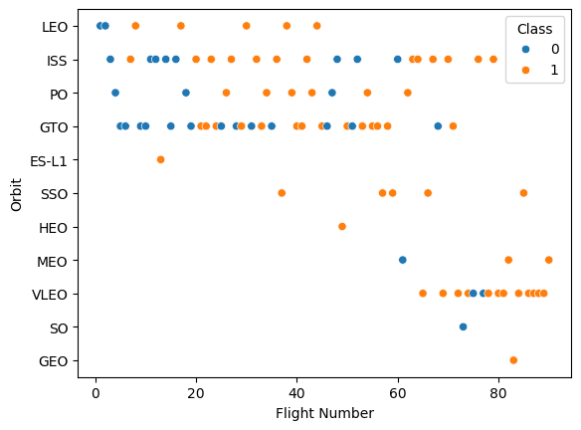
Flight Number vs. Orbit Type
It can be seen for LEO orbits, later flights improved successful outcomes.
For others like ISS, GTO, PO and VLEO, there appears to be no apparent relationship between later flights and outcomes.

Slide 22
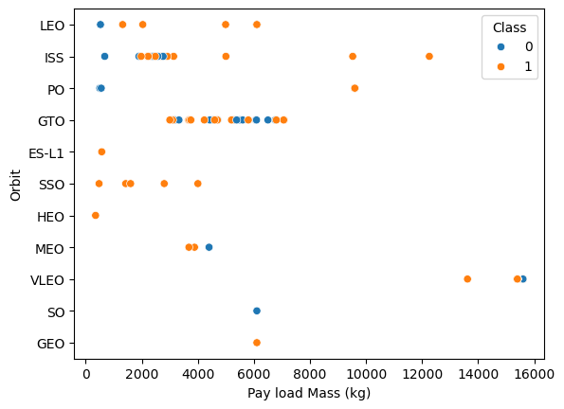
Payload vs. Orbit Type
For Orbit types Polar, LEO and ISS, as payload goes up, their successful outcomes also goes up.
However, for Orbit GTO this kind of relation is harder to identify as the payload does not seem to determine successful and failure outcomes.

Slide 23
Launch Success Yearly Trend
Since the Year 2013, the number of successful launches increases over the years, where it had dips in the year 2018 and 2020.

Slide 24
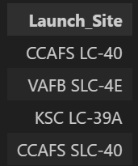
All Launch Site Names
There are 4 Launch Site used by SpaceX.
This is important information to based our later findings on.

Slide 25
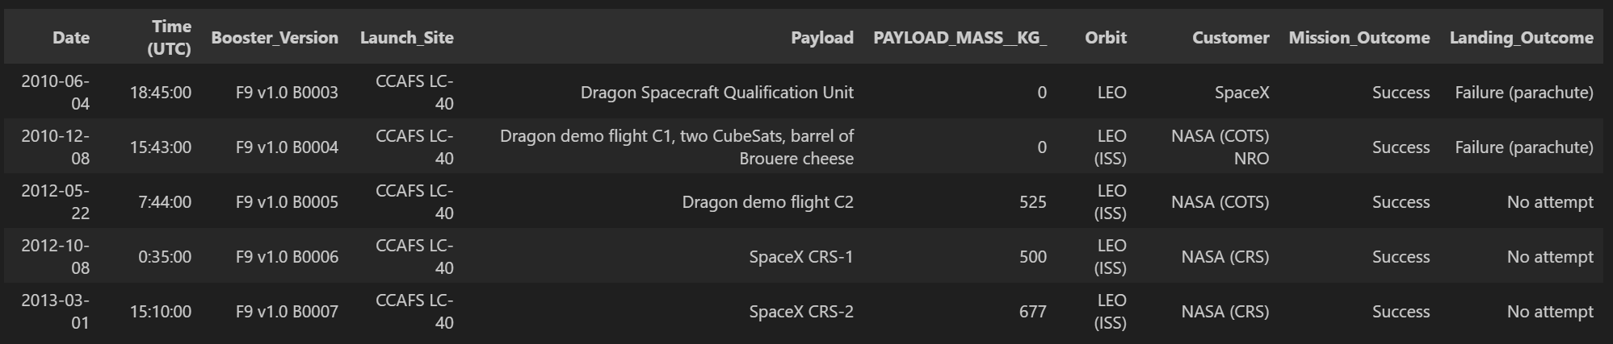
Launch Site Names Begin with 'CCA'
They were all launched from Site CCAFS LC-40.
Landing them were either failures or no attempts were made to do so
They had all used F9 v1.0 boosters.
This gives insight on the first couple launches done as the data is ordered by date with an ascending order

Slide 26
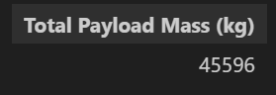
Total Payload Mass
The total amount of payload mass carried by NASA is a whopping 45596 kg.
This shows that NASA has lifted a lot of things from Earth into space.

Slide 27
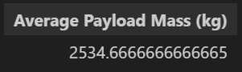
Average Payload Mass by F9 v1.1
The average payload mass for the booster F9 v1.1 is around 2534.66 kg.
This shows that this booster is used to handle payloads on the lighter side.

Slide 28

First Successful Ground Landing Date
This shows that SpaceX’s first ever successful ground pad landing was on 2015-12-22.

Slide 29
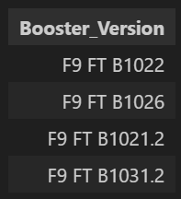
Successful Drone Ship Landing with Payload between 4000 and 6000
Booster Versions of F9 FT are the only ones that made successful drone ship landings.
This shows that for medium amounts of payload, booster F9 FT is the most consistent to successfully land on drone ships.

Slide 30

Total Number of Successful and Failure Mission Outcomes
There has been a total of 71 successful and failure mission outcomes by SpaceX
This shows SpaceX commitment to testing their technology in reaching their goals of Space Travel and making it cheaper.

Slide 31
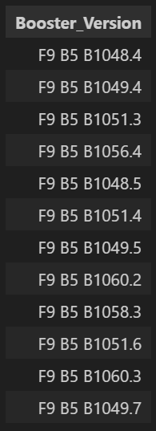
Boosters Carried Maximum Payload
The F9 B5 boosters are the ones that carry the maximum payload.
This may mean that this booster version is used to test up till the maximum payload while other booster versions are used for other purposes.

Slide 32
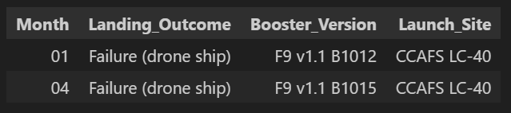
2015 Launch Records
2 failure landings to drone ships occurred in the Year 2015.
They failed in the months January and April where they with the same booster version “F9 v1.1” and on the same Launch Site “CCAFS LC-40”.
This showed that they attempted to land similar ships but failed both attempts, which may show the need for larger changes to be made

Slide 33
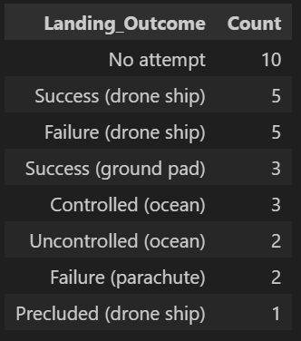
Rank Landing Outcomes Between 2010-06-04 and 2017-03-20
Between the dates 2010-06-04 and 2017-03-20, most landings were attempted as 21 landings were attempted and 10 were not attempted
In terms of successful and failed landings, the most common were drone ship landings with an equal number of successful and failed landings.
This may suggest that drone ships landings are the most favorable landing location for the team at SpaceX.

Slide 34

Section 3

Slide 35
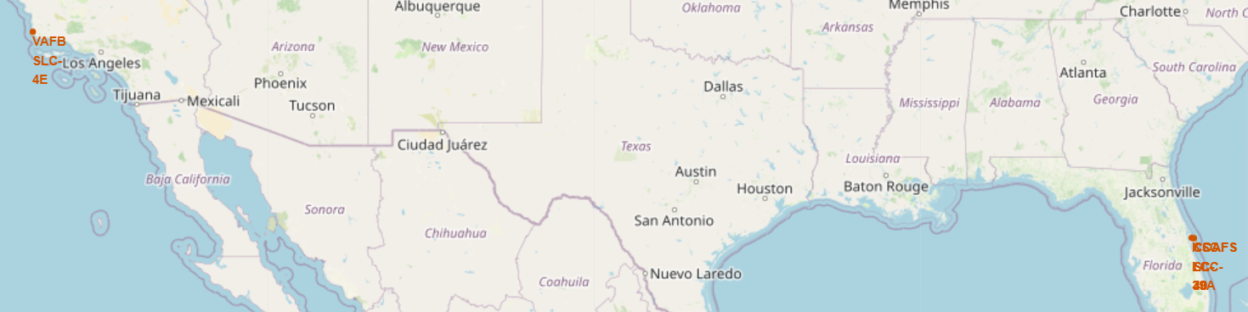
Launch Site Locations
There are 4 Launch Sites which includes:
CCAFS LC-40
CCAFS SLC-40
KSC LC-39A
VAFB SLC-4E
Site VAFB SLC-4E is near the west coast of the USA, while the other 3 launch sites are placed close to each other at the east coast of the USA in Florida.
Sites CCAFS LC-40 and CCAFS SLC-40 are right next to each other.

Slide 36
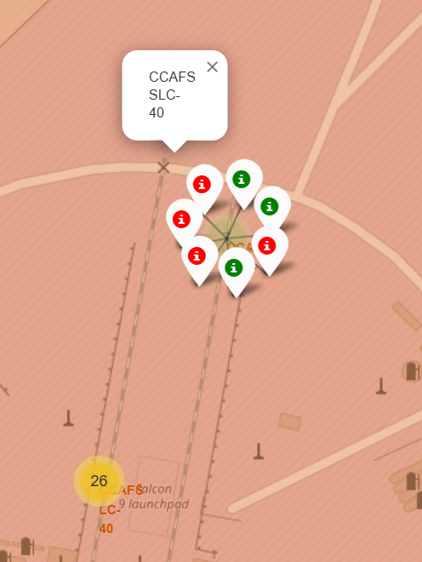
Color Labeled Launch Outcomes
The launch outcomes were plotted on the maps with green representing success and red meaning failure.
It was seen that for each site, failures and successes occurred and that there is are higher number of launches from the east coast. This makes sense as there are 3 launching sites there while only one on the west coast.

Slide 37
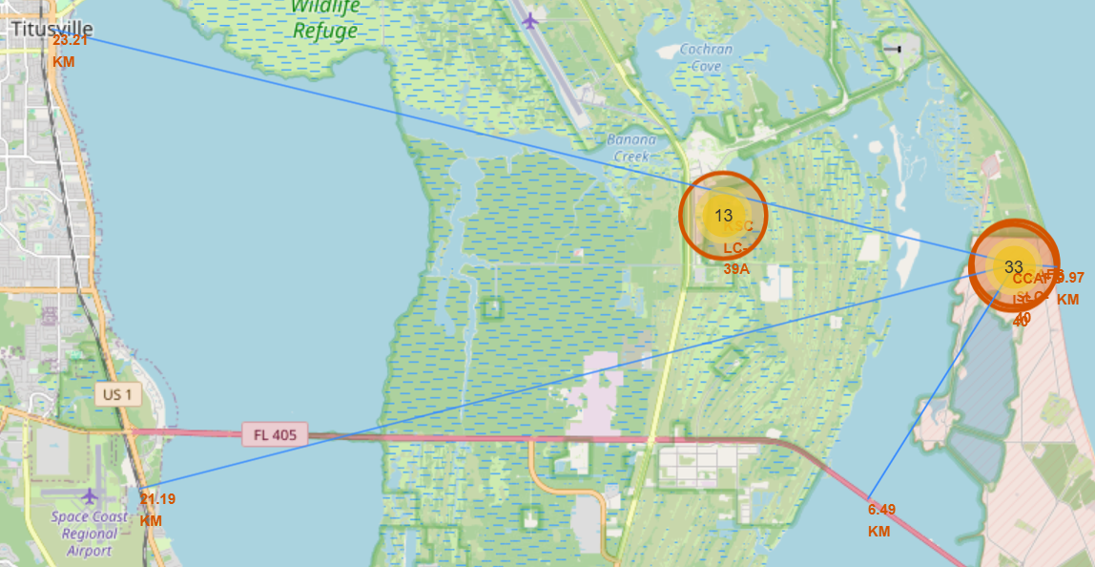
Proximities of Site CCAFS SLC-40
Proximities and Distances:
Coastline: 0.97 km
Highway: 6.49 km
Railway: 21.19 km
Nearest City/Town: 23.21 km (Titusville)
This shows that there are considerable distances between launch sites and areas of human commutes. This makes sense since launch and landings are typically extremely loud and hot hence having the sites be so far away from where people travel/live is a good safety measure.

Slide 38

Section 4

Slide 39
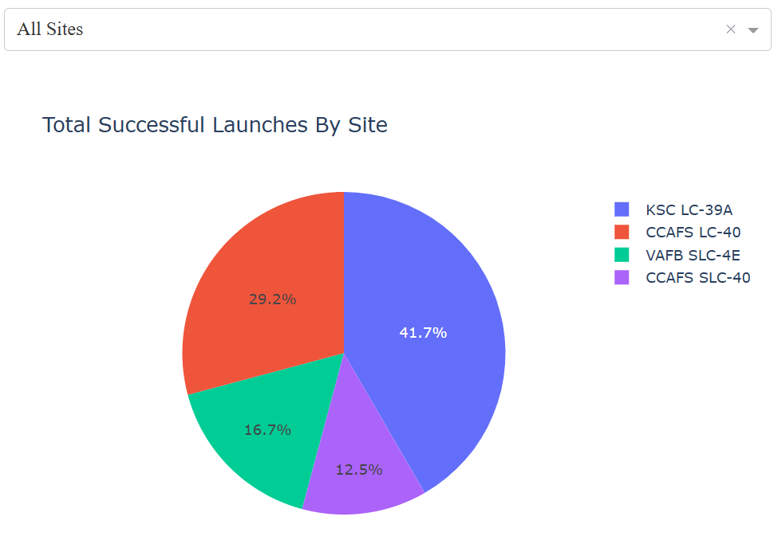
Total Successful Launches of each Site
Site KSC LC-39A had the most successful launches compared to the other sites.
Site CCAFS SLC-40 however, had the lowest number of successful launches.

Slide 40
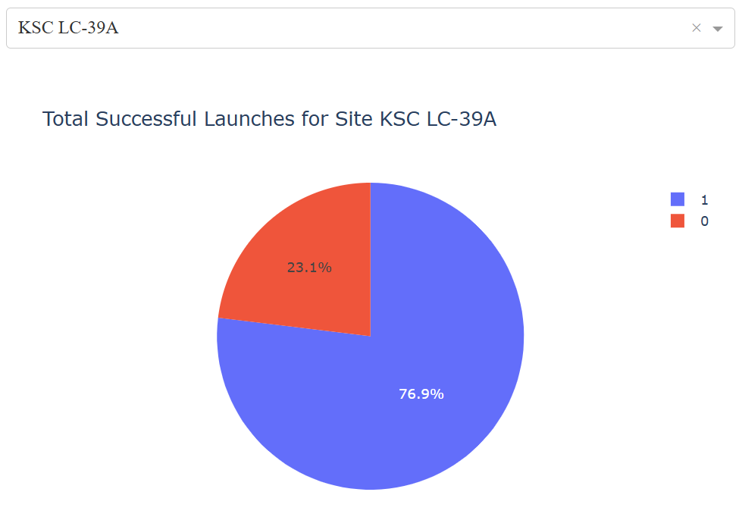
Highest Launch Success Ratio
Site KSC LC-39A had the highest ratio of successful launches to failed launches out of the other Sites.
A whopping 76.9% of the launches at this Site succeeded, showing that there might be something about the site that allows higher successes.

Slide 41
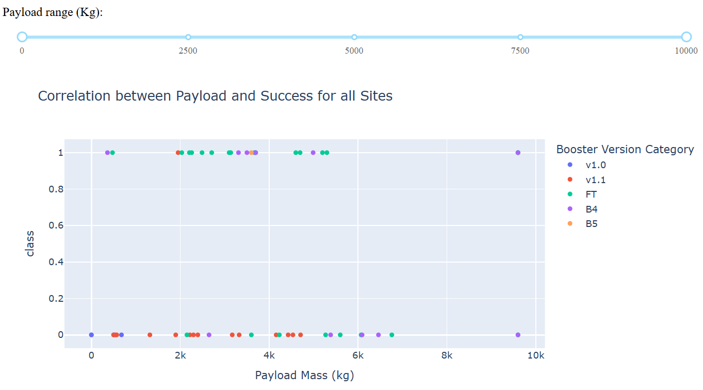
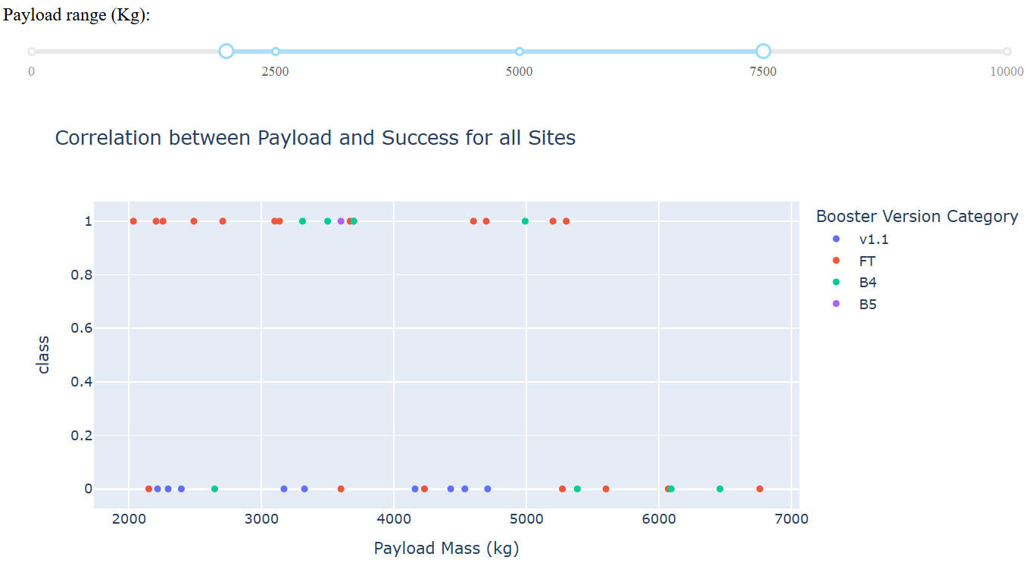
Payload vs Launch Outcomes
It can be seen in the scatter plots that, most launches have payloads between 0 to 7000 kgs.
FT boosters are more consistently having successful launches compared to other Booster Version Categories. It has the highest success rate.
However, FT boosters are not as successful when the payload exceeds 5500 kgs.
Full Range
Range 2000 to 7500

Slide 42

Section 5

Slide 43
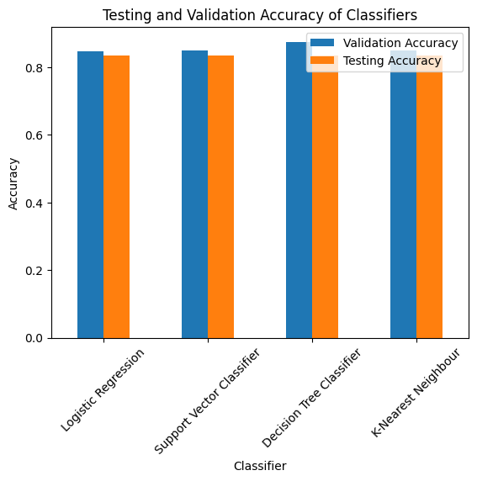
Classification Accuracy
All models had gotten the same accuracy of 83.33% using the Test set. Their testing performance was also proven to be the same as their confusion matrixes were all the same.
However, the Decision Tree Classifier had the highest Validation Accuracy showing that it was a cut above the rest.

Slide 44
Confusion Matrix
This was the confusion matrix of the Decision Tree Classifier (Best Classifier).
It was able to properly predict 15 labels and no False Negatives. However, it had predicted 3 False Positives showing that it has low Precision.

Slide 45
Conclusions
The chosen Decision Tree Classifier can consistently predict the outcome of SpaceX launches with somewhat low precision. Using this classifier, users can implement its predictive capabilities to support or be against SpaceX with their services.
As an outcome of this project, Interactive Maps and Dashboards were made to help is understanding and analyzing the SpaceX mission launch data users. Users can make use of them to more interactively learn of the data through a fun user experience.

Slide 46
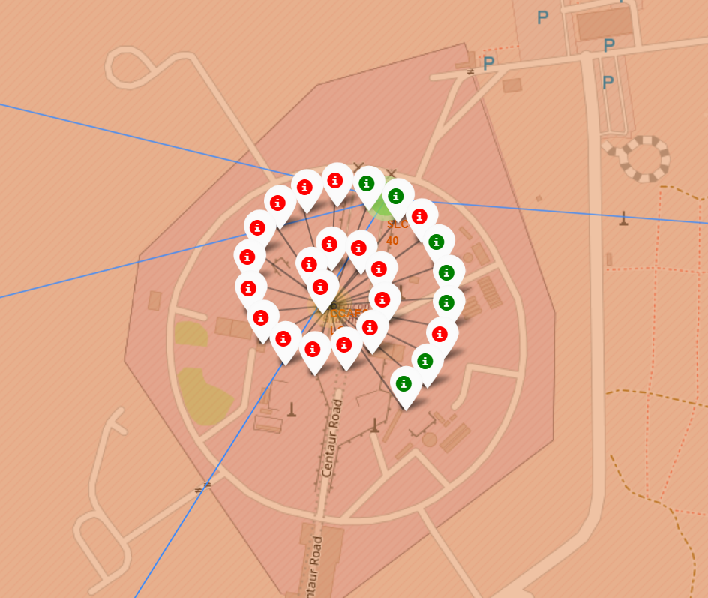
Appendix
Markers of the launches done on Site CCAFS LC-40
Green: Successful, Red: Failure

Slide 47


